Slide 1
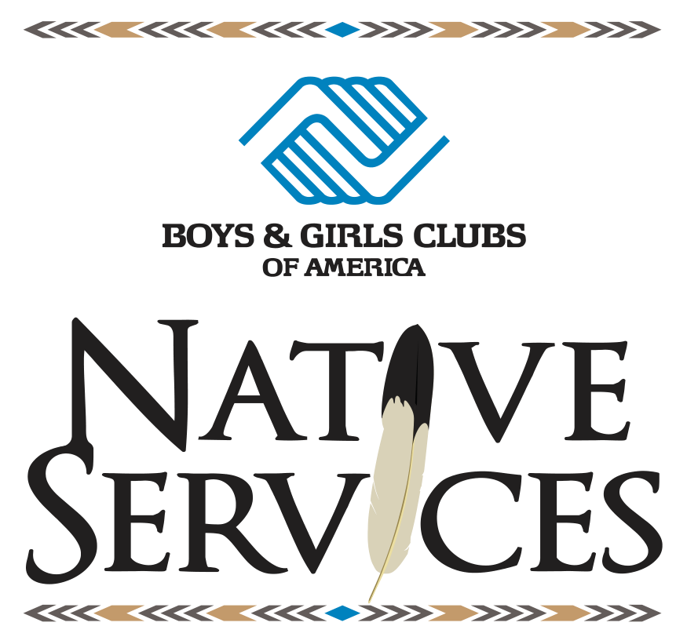
October 6, 2022

Slide 2
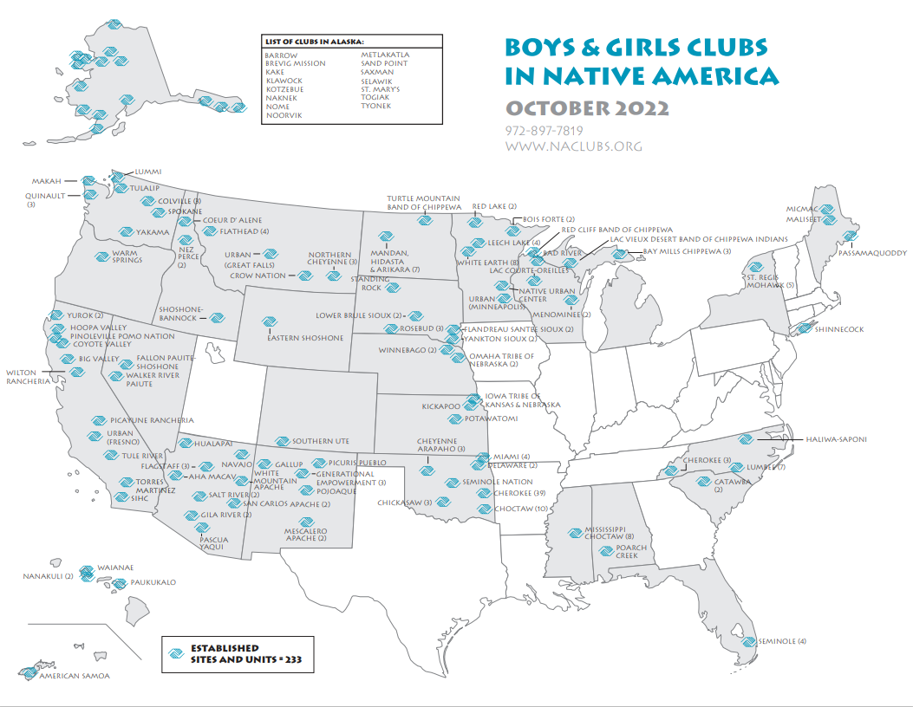
Notes:
Boys & Girls Clubs of America is the LARGEST Native youth provider opening the first Native Boys & Girls Club in 1992!
This year we are celebrating 30 YEARS of BGC’s on Native Lands! Today we have 233 Clubs on Native Lands in 28 States, serving over 125,000 youth representing 150 American Indian, Alaskan Native, Native Hawaiian and American Samoa communities.

Slide 3
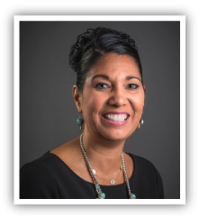
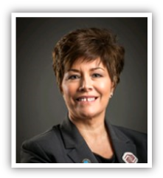
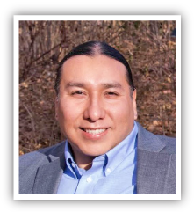
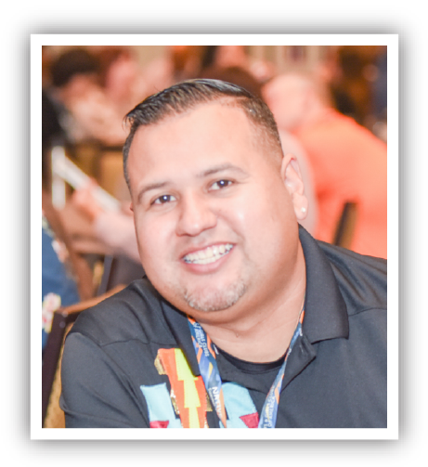
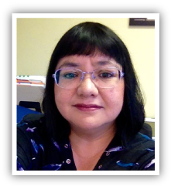
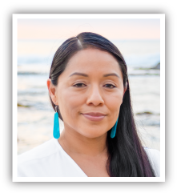
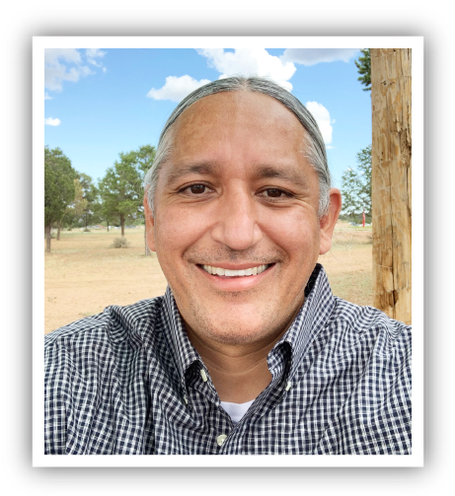
Notes:
Culturally competent service delivery and organizational support. Technical Assistance provided from team of Directors of Org Development with years of experience working in Indian country. We all represent various tribes located throughout turtle island.
Including the National Vice President of Native Services Ms. Carla Knapp in the upper corner of your screen.

Slide 4
Director of Organizational Development
Designated DOD for each state
Unique understanding of Native related issues that youth face
Provides direct support and tech assistance to all Native Organizations
Frequent communication & site visits
Link to resources and advise on program improvement
Individual & team consults for capacity growth
Notes:
The Role of the DOD.

Slide 5
Partnering with Tribal Leaders & Communities
Boys & girls Clubs of America: empowering Native Youth
BGCA honors and respects the leadership and ability of Native people to decide how best to serve their tribal communities. BGCA’s Native Services team, led by people of Native heritage, assists with capacity-building at 230 Native Clubs by:
Building and sustaining partnerships with Tribal leaders and stakeholders.
Developing leaders at all levels in Native Clubs through professional development.
Strengthening Native youth’s cultural identity with customized Club programming.
Expanding our reach to underserved tribal communities.
Notes:
As an international Non-profit BGCA operates as a federated model. Which creates an ideal environment for partnering with tribal nations.
BGCA respects tribal sovereignty, and Native peoples’ abilities to decide how best to move their tribal communities forward. Over the past 30 years, we have partnered with tribal nations, supporting their efforts to create opportunities for Native youth to succeed. Native youth draw strength from their culture, and Boys & Girls Clubs in Indian Country support deepening Native youth’s cultural identity through programming that promotes positive youth development.
In 2013, BGCA created the Native Services Unit, a department within our organization--intentionally led by people of Native heritage--to provide direction and strategy for Native Clubs. The Native Services Unit assists in capacity building at Native Clubs, including developing leaders at all levels of our Native organizations. Rooted in the cultural and historical context of Native communities, the Native Services Unit enhances our ability to:
Build and sustain collaborations with tribal leaders and stakeholders;
Provide professional development and networking specifically for Native Clubs; and
Strengthen Native youth’s cultural identity through customized culturally competent programming.

Slide 6
BGCA Programs Adapted
Boys & girls Clubs of America: empowering Native Youth
Proof of Our Impact
For 30 years, Boys & Girls Clubs have provided Native kids and teens with safe spaces, caring mentors and skill-building programs, resulting in proven positive impact:
BGCA Programs:
All Stars
Diplomas to Degrees
DIY STEM
Healthy Habits
My.Future
Project Learn
SMART Girls
SMART Moves
BGCA Resources:
Workforce Development Assessment Tool
Be There
Trauma Informed Pathways to Healing
Trauma Informed Network Guide
98% | of kids and teens at Native Clubs receive As & Bs in school.
88% | of youth at Native Clubs expect to graduate high school while 85% plan to earn a college degree.
92% | of youth at Native Clubs abstain from alcohol while 89% abstain from marijuana.
92% | of youth at Native Clubs try to help others in need.
Notes:
Native Services has worked to adapt leading evidence-based youth development programs for clubs on Native lands to offer culturally appropriate programming.
Additionally, for 30 years, Boys & Girls Clubs have provided Native kids and teens with safe spaces, caring mentors and skill-building programs, resulting in proven positive impact:
98%
of kids and teens at Native Clubs receive As & Bs in school.
88%
of youth at Native Clubs expect to graduate high school while 85% plan to earn a college degree.
92%
of youth at Native Clubs abstain from alcohol while 89% abstain from marijuana.
92%
of youth at Native Clubs try to help others in need.
My personal professional journey has always been an emphasis on the prevention of youth suicide in Native communities. Through my journey one of the key teachings from elders and cultural advisors is that to truly impact the lives of youth and our tribal communities we must work upstream. It is my belief that the boys and girl's clubs on native lands are doing this upstream work.

Slide 7
The State of Native Youth in America
BOYS & GIRLS CLUBS OF AMERICA: EMPOWERING NATIVE YOUTH
Native youth face more barriers to life and academic success:
Native youth are more likely to be exposed to crime:
Native youth have a higher mortality rate than any other race:
Native communities face nearly double the rate of violent crime compared to the general population.
Native youth are twice as likely to die before age 24 than members of any other race.
More than 1 in 3 Native youth live in poverty.
2x
15% of Native youth are involved in gang activity, compared to 8% of Latino youth and 6% of Black youth.
Only 68% of Native youth are scheduled to graduate high school on time.
Native youth have the highest suicide rate of all races for youth ages 15-24.
15%
Notes:
As we know, Native youth face challenges at higher rates, including disparities in health, education and income, compared to other Americans:
18% of Native youth attend college, and only 9% earn college degrees
1 in 3 Native youth (compared to 1 in 6 non-Native) live in poverty
Native youth are more likely to experience alcoholism, obesity and Type I diabetes with a 68% increase in Type II diabetes over the past decade
We also know that native youth are impacted by mental health issues. That is why in addition to the great work of Native clubs they also strive to incorporate trauma informed practices within their club programming and throughout the organizational structures. Recognizing that there are large gaps of culturally competent mental health providers across Indian country clubs provide a safe place for native youth to thrive. In communities across Indian country, Boys and Girls clubs are the community hub of hope and light. That is why the Native Services has the mission by 2025 there will be 250 clubs and serving 130,000 Native youth.

Slide 8
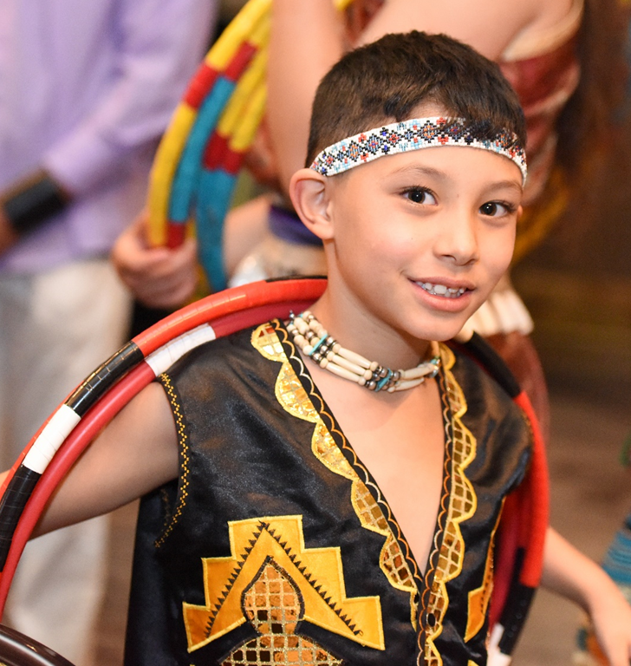
Bringing Opportunity to Native Kids & Teens
Boys & girls Clubs of America: empowering Native Youth
With a rich cultural heritage to draw strength and support from, Native youth have a wealth of unique opportunities and potential. Boys & Girls Clubs in Native communities activate that potential, contributing to:
COMPETITIVE GRADUATES
21st century nATIVE leaders
A HEALTHIER GENERATION
Notes:
As the largest nonprofit service provider to Native youth, BGCA is doing whatever it takes to help Native Clubs build the competencies needed for Native youth to thrive in school, career and in life.
Clubs bring opportunities, teach life skills, provide additional support, role models and mentoring, and so much more.

Slide 9
Cortney Yarholar, LMSW Director of Organizational Development
Native Services, Boys & Girls Clubs of America cyarholar@bgca.org (405)264-3633

